Slide 1

590 PR - Final Assignment
Analytics through Monte Carlo Simulation
Goalkeeper Success Rate Simulation
Claire Wu | Salonee Shah | Samuel John
Notes:
http://chesmontsports.com/wp-content/uploads/2015/10/soccer22.jpg

Slide 2
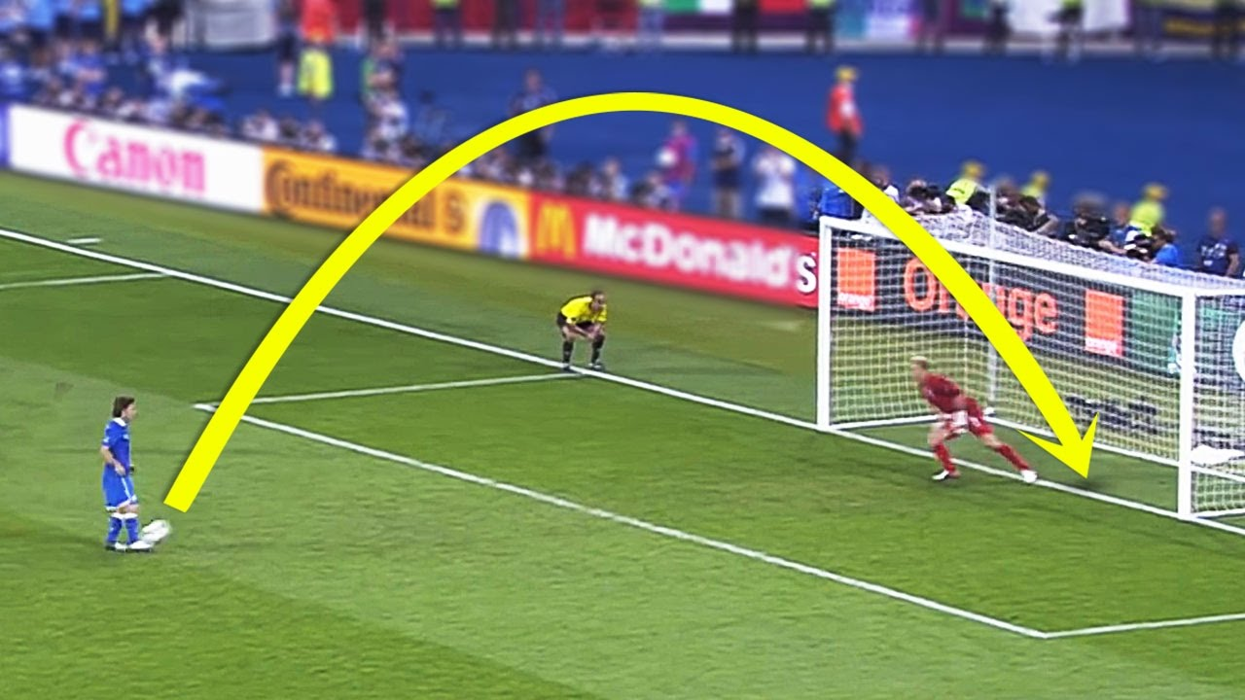
What is a Penalty Kick/Penalty Shootout?
A penalty is awarded to a team when the opponent team commits a foul within the penalty area
The shot is taken from the Penalty Mark, which is 12 yards from the goal line
Defended only by the opposing team’s goal keeper
A penalty shootout is a series of penalty kicks that is held at the end of the match, if the scores are tied.
https://i.ytimg.com/vi/Rv3v7ZfYp-g/maxresdefault.jpg
https://en.wikipedia.org/wiki/Penalty_shot#Association_football

Slide 3
Objective
of the Program
Scenarios we are working on now
Simulate the success percentage of a goalkeeper during penalties
Goalie jumps in a random direction (Completed)
Goalie jumps in the direction of the opponent Team’s most frequent shoot direction (In progress)
Check if using different strategies can improve the goalkeeper’s success rate or not
Goalie jumps in the direction of each opponent’s most frequent shoot direction (Completed)

Slide 4
Hypothesis & Assumptions
Hypothesis:
Saving the ball based on team’s most frequent kicking direction/each striker’s most frequent kicking direction can increase the success percentage of a goalie
Assumption:
If goalie's direction is the same as striker's direction, the goalie wins
Striker has 3 kicking directions and Goalie has 3 saving directions
Striker’s kicking direction will not be changed based on Goalie’s behavior(In Scenario 2&3, If Goalie found a team’s or a player’s frequent direction, and always save the ball in that direction, striker’s kick will not be affected or changed)

Slide 5
Process
1) Work on Hypothesis and Assumptions
2) Determine Variables/Scenarios
(Variables: striker kick direction, goalie save direction, etc.)
3) Use Monte Carlo to realize the Simulation for Three Scenarios
Scenario 1 – Random direction
Scenario 2 – Based on team tendency
Scenario 3 – Based on player tendency

Slide 6
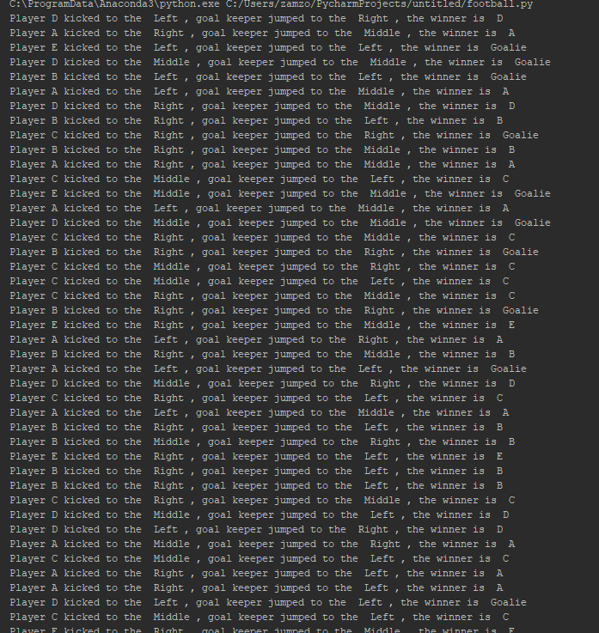
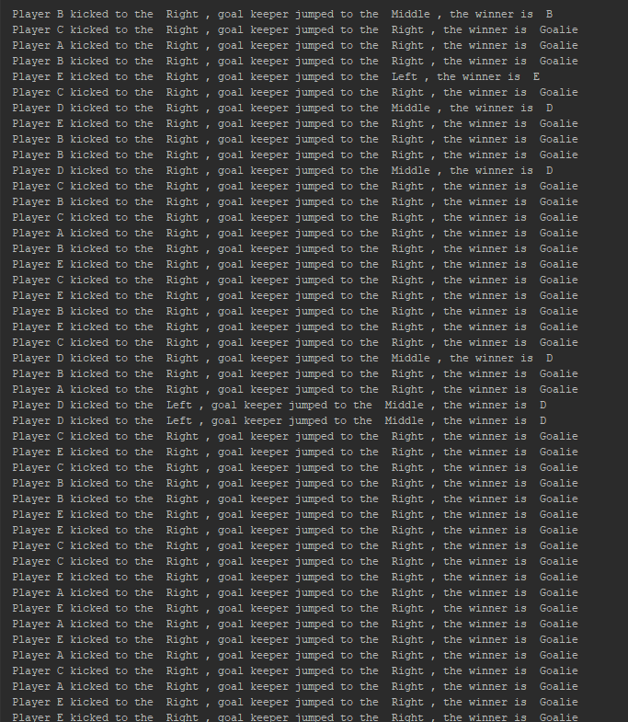
Scenario 1
Scenario 2

Slide 7
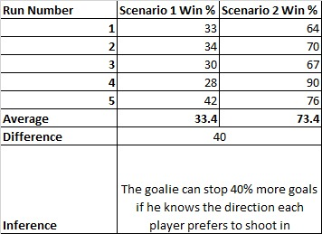
Result for Scenario 1&3 for 3 directional play

Slide 8
Limitations
Future Work
Our code randomly simulates a striker’s moves instead of using a large real dataset since the datasets available are quite small and have only 3 directions
Historic moves may not be a true representation of future striker’s move
Striker’s kicking direction is randomly simulated, but in reality, strikers may change their strategy based on Goalie’s past behavior
A player’s shooting leg could affect the direction of the kick (e.g. Players using their right leg could favor kicking to the left). We are currently trying to incorporate this into our code, however, the data available for this is minimal and our assumptions are based on re-sampling of the limited csv data that is available
We are considering adding a few cases to our code:
Increase the number of directions from 3 (Left, Middle, Right) to either 8 or 9 (Left Top, Left Mid, Left Bottom, Middle Top, Middle (Middle Mid, Middle Bottom), Right Top, Right Mid, Right Bottom)
Goalie jumps based on team/player tendency, including striker kick speed and goalie reaction time
Create two teams, run a penalty shootout scenario and select the winning team
Consider cases where the striker misses the penalty irrespective of direction (striker kicks outside the goal/hits the post)

Slide 9
Thank You!

